Slide 1
Paper Introduction: Context Encoder: feature learning by inpainting
Graduate School and Faculty of Information Science and Electrical Engineering
Department of Informatics
M1 CAO SHILEI
2019.11.11
SAKURAI LAB
Notes:
Introduction
Related work
Approach
Conclusion and future works

Slide 2
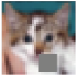
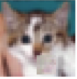
Purpose
This paper proposed a new framework which is based on adversarial machine learning for image inpainting
(example of Cifar-10)
Notes:
This paper proposed a framework jointly use a convolutional encoder-decoder network and adversarial machine learning in order to reconstruct the image with a masked hole

Slide 3
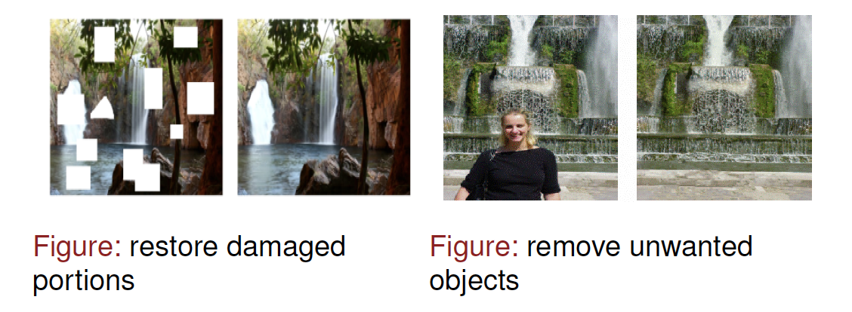
Inpainting
Image inpainting is the process of reconstructing missing parts of an image. This technique is often used to remove unwanted objects from an image or to restore damaged portions of old photos
Notes:
Image inpainting is the process of reconstructing missing parts of an image so that observers are unable to tell that these regions have undergone restoration. This technique is often used to remove unwanted objects from an image or to restore damaged portions of old photos. The ﬁgures below show the example of image-inpainting

Slide 4
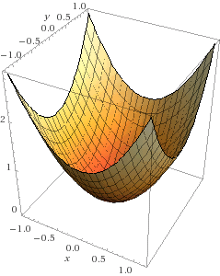
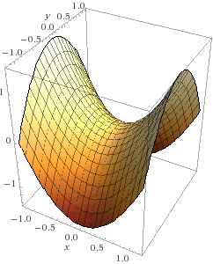
Adversarial Machine Learning^{[5]}
Traditional ML: optimization
Adversarial ML: game theory
Minimum
Equilibrium
One player, one cost
More than one player,
more than one cost
Notes:
The basic idea behind adversarial machine learning is that it extend machine learning from one player which has one cost function representing their interests.
instead, adversarial machine learning dealing with more than one player with more than one cost function,
on the left we show what the loss function looks like in a traditional machine learning algorithm, we have some kinds of cost function that takes player parameters and describes how well that player performs. Higher cost means the worse performance so that maybe something like the negative log likelihood assigned to the labels on a training data set. For example, what is the negative log probability the model will assign the correct labels to all of the different images in an object recognition data set
this is the way we train things like classifiers and many different kinds of generative models and even some kinds of reinforcement learning
we show what happens when we start to have more than one player and more than one cost. So a player might be something like a machine learning model or it might also be a person or a program that is trying to interfere with the operation of a machine learning model you will see a lot of concrete examples. But what we can think about easily is the example of spam detection. we have machine learning model that wants to recognize spam and we have spammers who want to get their spam through the system we can model this at the language of game theory and draw a value function where we are looking for a point called Nash equilibrium that is simultaneously a minimum of the defending players cost and a maximum of the attackers attacking player cost. So, this is for example a point where the spammers can not get anymore spam through the system unless they were somehow able to change the spam detector and the spam detector is not able to get anymore accuracy unless it was somehow or other able to change the spam generation algorithms used by the spammers.

Slide 5


Framework
autoencoder
encoding
encoder
decoder
discriminator
GAN
Notes:
Now let us review the framework of this paper.
This is the overview architecture and the paper co-operate autoencoder and GAN to reconstruct the masked block
We use autoencoder to recreate the masked part and use GAN to optimize
So please allow me to introduce the GAN and autoencoder first

Slide 6
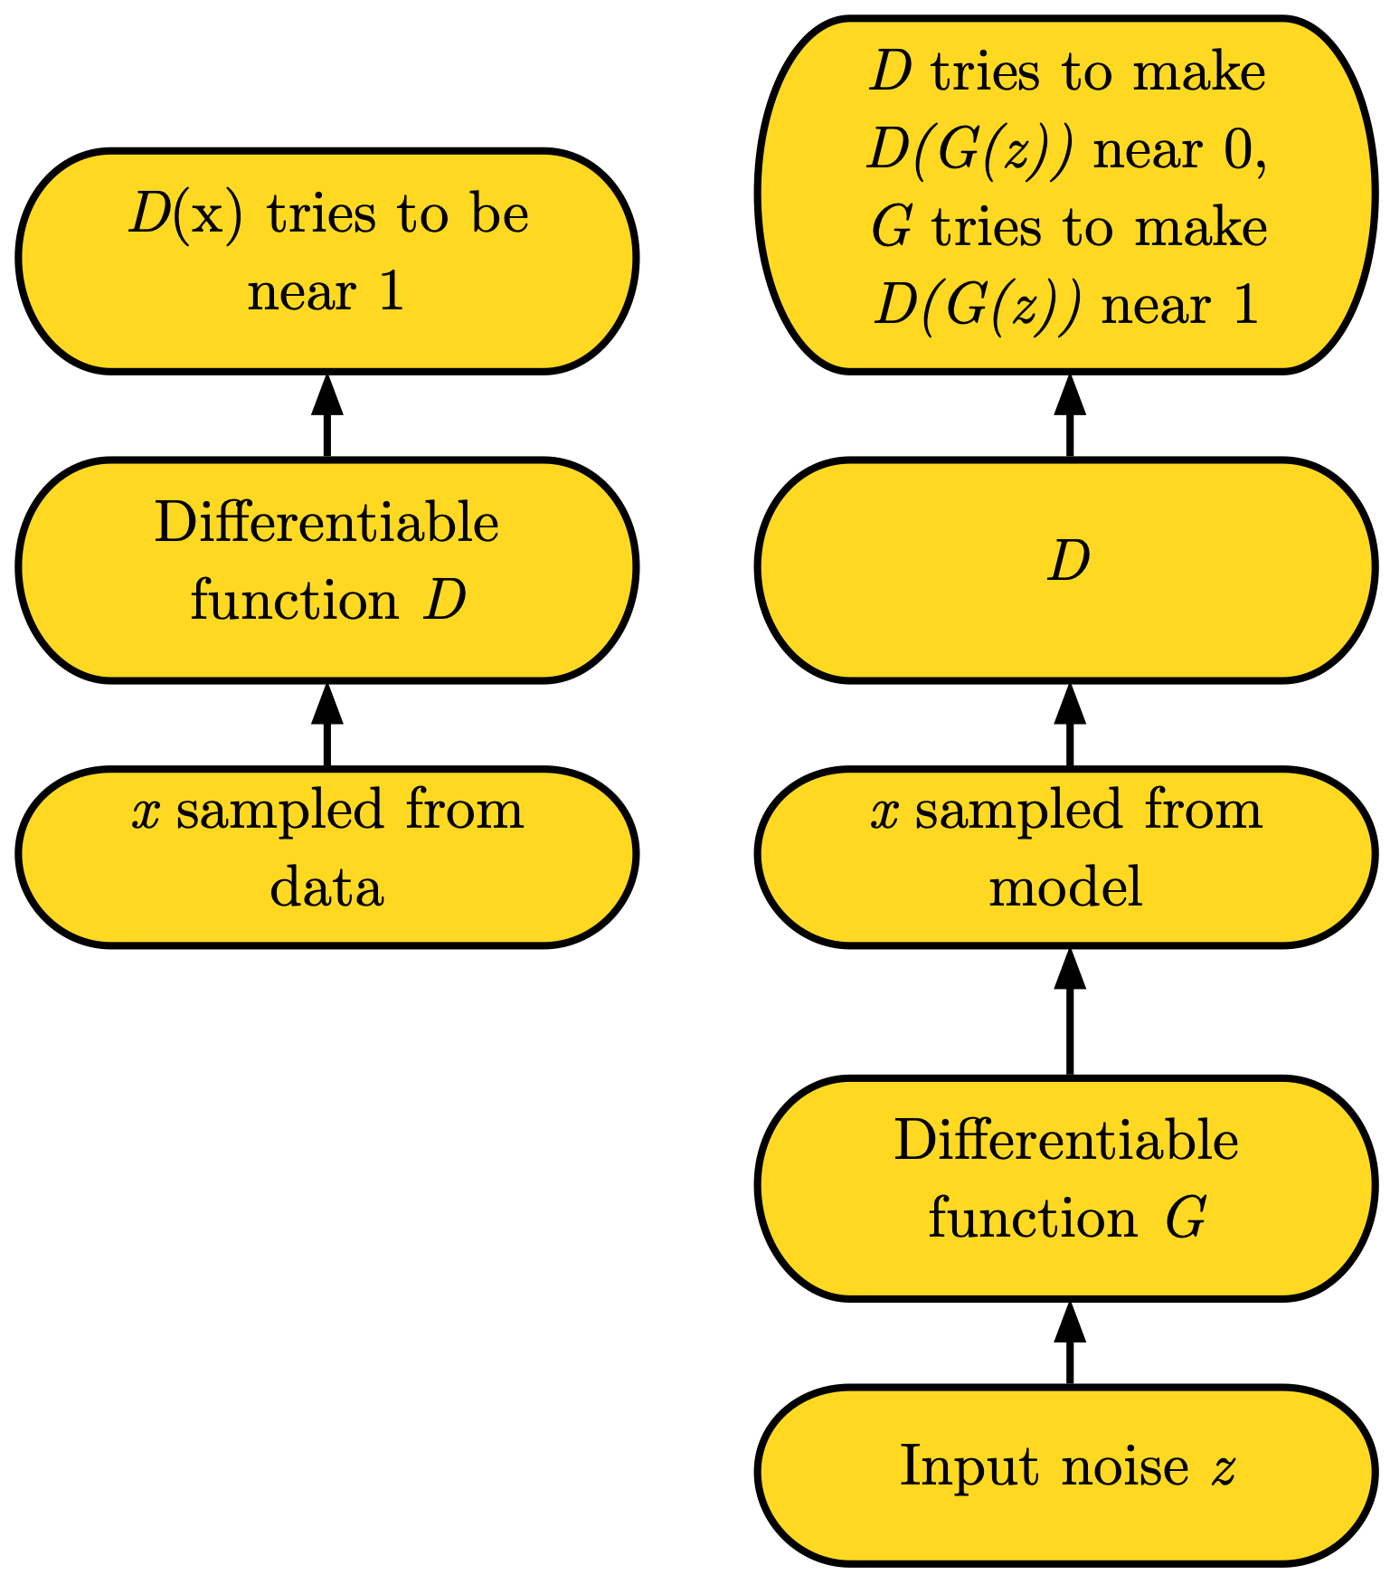
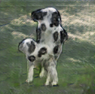
generative adversarial network (GAN)^{[4]}
5
Notes:
Adversarial network later be developed as generative adversarial network (GAN) is proposed by Goodfellow in 2014. The basic idea behind this framework is to make a contrived game between two different players. It was named contrived because we actually control both players and we want them to compete. Here for the generative adversarial network framework, we create an imaginary conflict in order to force both players to get better. One of the players is a network called discriminator that we present with a capital letter D. The idea of the discriminator is that it is a deep neural network that acts as a classifier it looks at the input and it guesses whether the input is real or fake. So, for example, we might input a real photo of moth shown on the left side of the slide and run it through the discriminator Network the discriminator network will try to output a number near 1, indicating that the probability of the input being real rather than fake is high. We start to see that this is a game when you play another player, the generator. The generator takes random noise and transforms it to produce outputs that resemble the training data. Early in training, the generator will not actually produce realistic images. I’ve illustrated this by showing the image of the animals that is kind of like a cow that is both quadrupedal and bipedal at the same time. This is a defective simple that came from a generator network and over the course of learning we will train the discriminator to reject these kinds of images. The way it works is we begin by sampling a noise vector that we call Z. you can think of noise as being a little bit like the seed for a pseudo-random number generator it is source of randomness that allows an otherwise deterministic system to have many different behaviors. We take the noise vector z and we transform it until we get something in the same format as the training data using a neural network called the generator represented by capital letter G. After we have obtained this image, we then feed it forward to the discriminator. Previously we gave the discriminator a real image and the discriminator tried to out put the value near 1, now the discriminator try to output a number near 0. However we also train the generator to try to fool the discriminator to try to make the discriminator output a value near 1. It turns out that you can analyze this through the language of game theory and we can think of there being a Nash equilibrium that indicates exactly the situation the generator has recovered the training distribution perfectly at the Nash equilibrium.
the best that the discriminator can do is guess randomly and the generator is able to perfectly reproduce the training data.

Slide 7
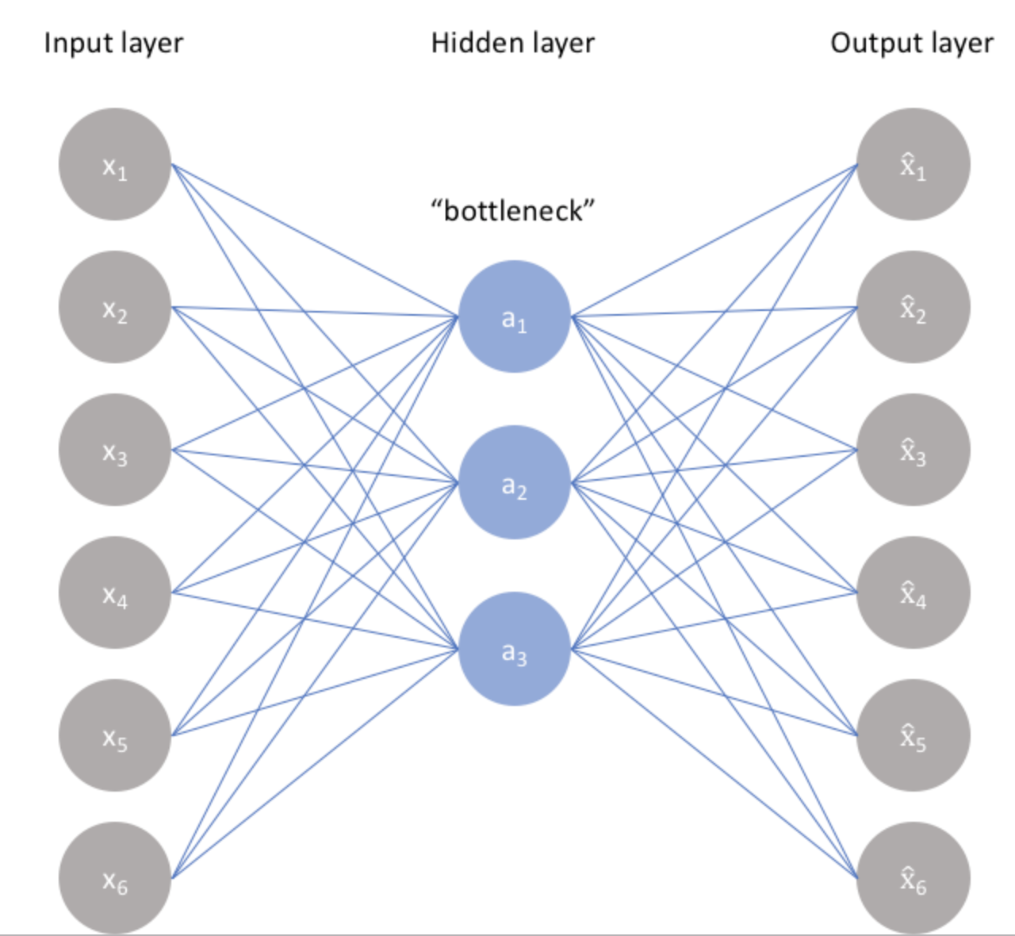
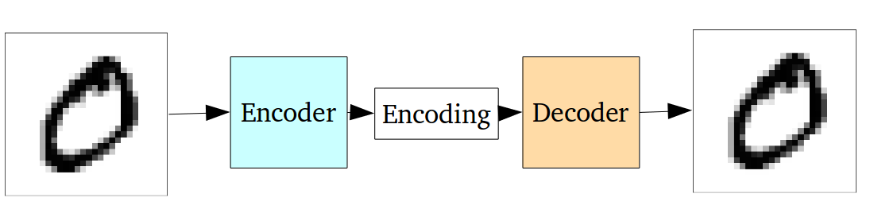
Autoencoders^{[6]}
Loss function
Notes:
What is autoencoder does is it takes some kind of input data, which could be an image or a vector anything at all with a very high dimensionality, it is gonna to run it through this neural network and it is gonna to try to compress the data into a smaller representation. It does this with two principal components. The first components is what we call the encoder, the encoder is simply a bunch of layers they can be fully connected layers or convolutional they are going to take the input and then it is going to compress it down to a small representation which has less dimensions than the input and this is what we call the bottleneck, and then the bottleneck is going to try and reconstruct the input by using again fully connected or convolutional layers. And then the loss function of training an autoencoder is simply looking at the reconstructed version at the end of your encoder network. Then, you are going to simply compute the reconstruction with respect to your input and simply comparing pixel to pixel differences in the output. We can create a loss function and we can start training our network to compress images, and so obviously you have simple encoders that use fully connected layers but you can just as well swap them out with convolution
If you are looking what is going on here. if you train a deep convolutional network to do encoding and decoding of a whole brunch of images, you are actually creating a whole new kind of compression algorithm.
When we get reconstructions from autoencoders it look pretty ok but maybe fuzzy. The fuzziness is because you force the entire information of your image to go through the bottleneck layers dimensionalities. And then when we construct obviously lose some of that detail.

Slide 8
Inpainting using autoencoders
conv
encoder
deconv
encoder
encoding
7
Notes:
So autoencoders can just used for inpainting. we can simply crop a rectangular area out of the image and throw it away. We replace it with grey pixels. We feed that input image through the network and we try to reconstruct the original full image.

Slide 9
Context encoder
Regress the cropped part
encoder
decoder
encoding
discriminator
MSE loss
GAN loss
Notes:
But today, we would like to introduce a more complexed structure for image inpainting.
Now let us see the context encoder which is put up in this paper and have a great result in image inpainting.
The overall architecture in VE part is a simple encoder-decoder pipeline.
The encoder takes an input image with missing regions and produces a latent feature representation of that image.
The decoder takes this feature representation and produces the missing image content.
Then we consider the autoencoder as the generator, add with the discriminator, it is just a adversarial generative network. Then, they begin zero-sum game, and try to find the Nash equilibrium .

Slide 10
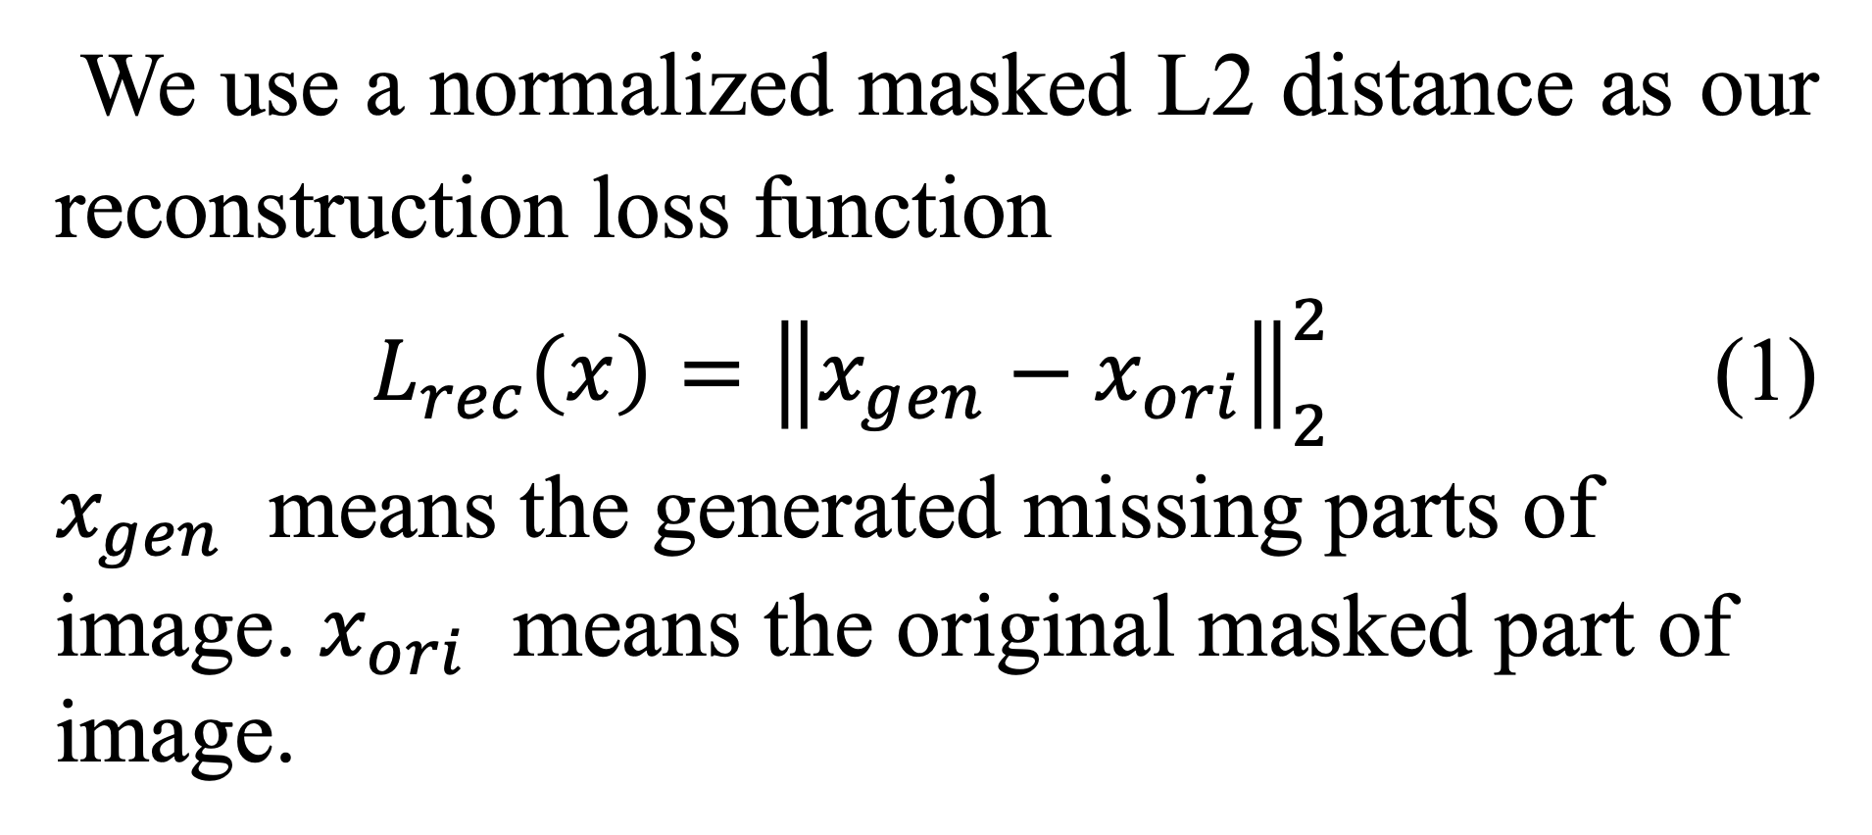
Loss Function
We use a normalized masked L2 distance as our reconstruction loss function
$L_{rec}\left(x\right)={\left\|x_{gen}−x_{ori}\right\|}_{2}^{2}$ (1)
$x_{gen}$ means the generated missing parts of image. $x_{ori}$ means the original masked part of image.
Notes:
The loss function the paper use is very special since we need to generate the contents of an arbitrary image region conditioned on its surroundings
SO context encoders need to both understand the content of the entire image, as well as produce a plausible hypothesis for the missing part(s).
In this way, this paper proposed a joint loss, including a standard pixel-wise reconstruction loss and an adversarial loss.
The reconstruction (L2) loss is responsible for capturing the overall structure of the missing region and coherence with regards to its context, but tends to average together the multiple modes in predictions.

Slide 11
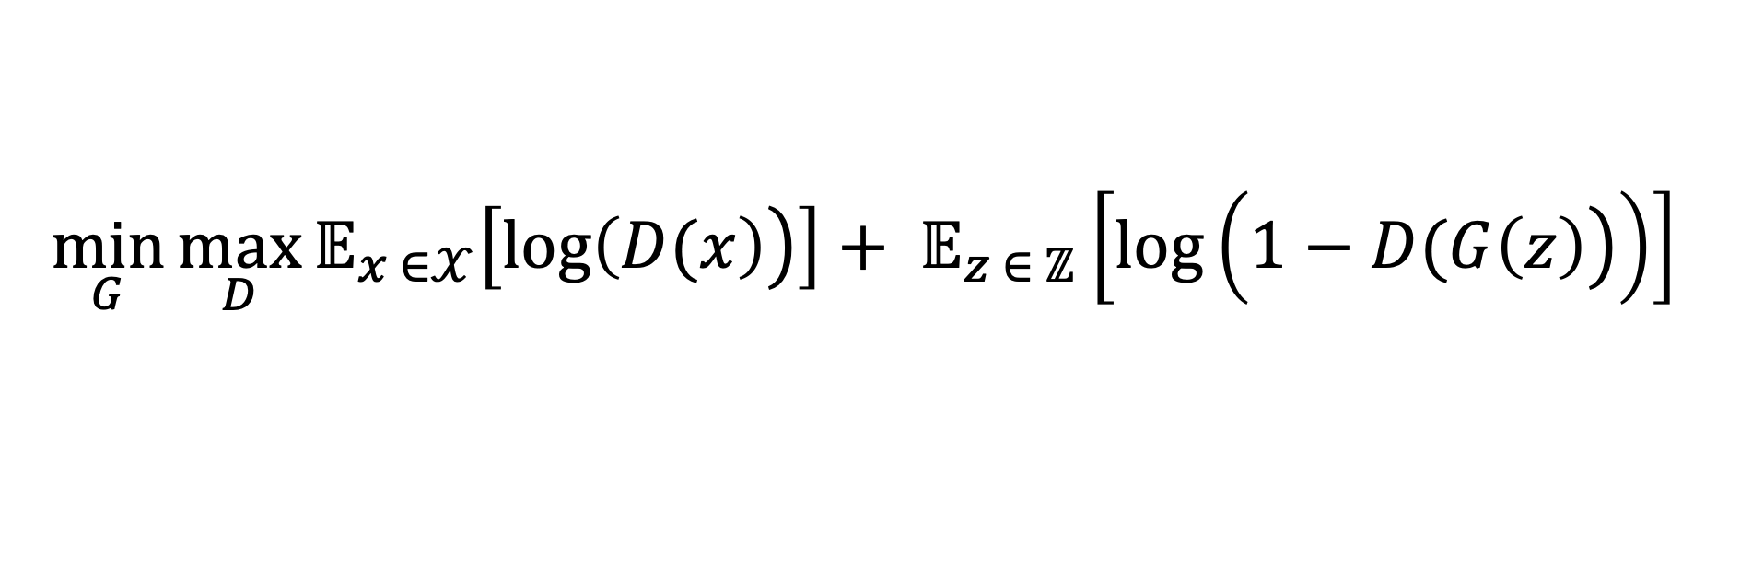
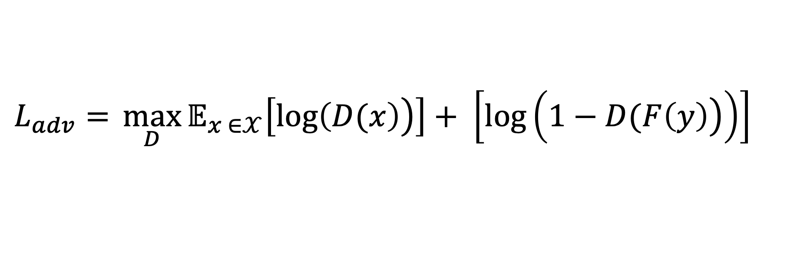
Loss Function
Our adversarial loss is based on GAN,
$$\min_{G}{\max_{D}{𝔼_{x ∈𝒳}\left[\log\left.\left(D(x\right)\right)\right]+ 𝔼_{z ∈ ℤ}\left[\log\left(\left.1−D(G\left(z\right)\right)\right)\right]}}$$
(2)
We thus use an alternate formulation, by conditioning
only the generator on context.
$$L_{adv}={\max_{D}{𝔼_{x ∈𝒳}\left[\log\left.\left(D(x\right)\right)\right]+ \left[\log\left(\left.1−D(F\left(y\right)\right)\right)\right]}}$$
(3)
Notes:
The adversarial loss, on the other hand, tries to make prediction look real, and has the effect of picking a particular mode from the distribution.

Slide 12
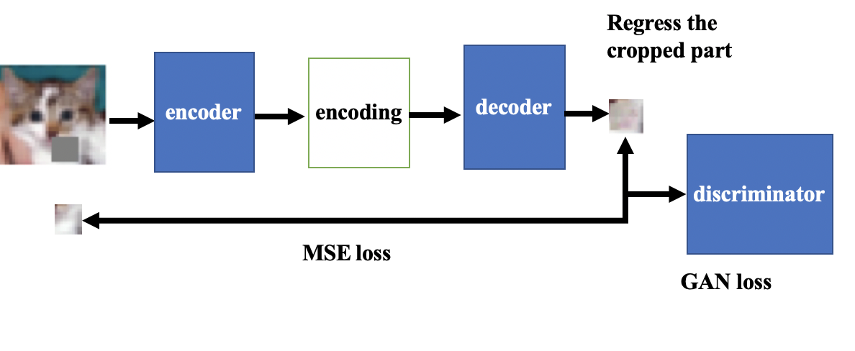
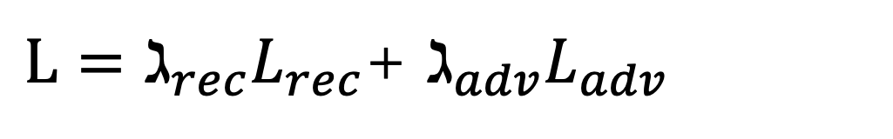
Joint Loss
$L=ℷ_{rec}L_{rec}$+ $ℷ_{adv}L_{adv}$
Notes:
SO we jointly use these two losses and optimize the parameters.
Let us review the structure again
The overall architecture is a classic Adversarial Neural Network (GAN)^{[3]} but change the generator as a simple encoder-decoder pipeline. The encoder takes an input image with missing regions and produces a latent feature representation of that image. The decoder takes this feature representation and produces the missing image content
At last use Adam optimizer to backpropagate optimize the parameters,

Slide 13
My Simulated Dataset
Dataset: ImageNet Large-Scale Visual Recognition Challenge (ILSVRC) ^{[7](}2015)
A subest of ImageNet, 256*256 color images , The datasets comprised approximately 1 million images and 1,000 object classes
32x32 color images in 2 classes, with 6000 images per class
2 classes of Cifar-10 ^{[8]}
Notes:
The datasets this paper used is ImageNet, However, since the GPU and time limited, ImageNet may trained for several weeks In my computer, so I change the dataset into 2 sets of Cifar10, cats and dogs. It still works well, and here is the structure I changed a little and the result.

Slide 14




Experience environment
Models are implemented on
Ubuntu : 18.04.2 LTS
Python: 3.73
Tensorflow : 1.14.0
Keras : 2.2.4
Run in hardware
CPU:Intel(R) Core(TM) i7-3960X CPU @ 3.30GHz
13

Slide 15
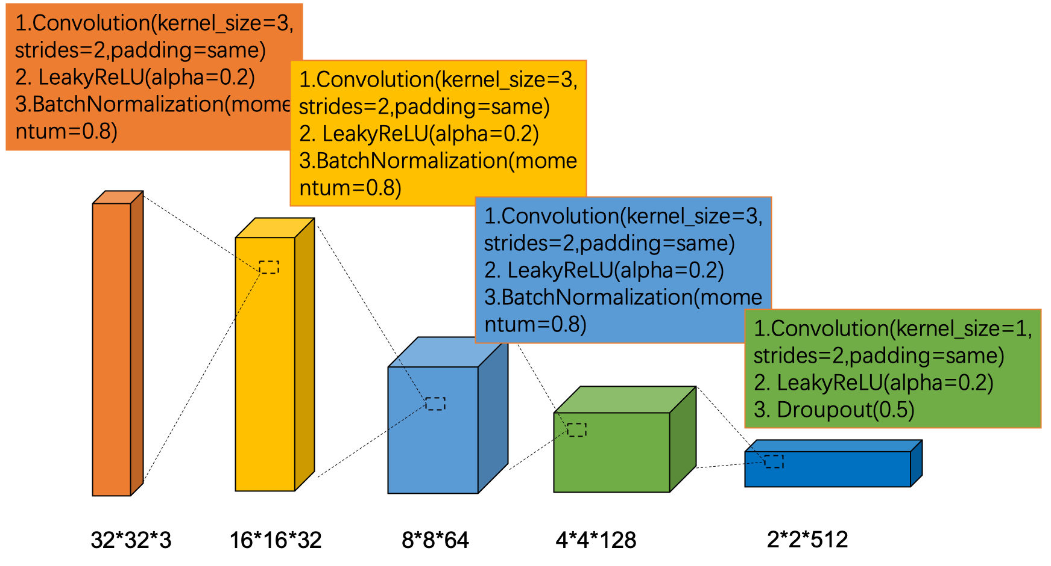
My simulated Structure encoder
Notes:
Our encoder is derived from the AlexNet architecture.
Given an input image of size 32*32, we use the convolutional layers and the following pooling layer to compute an abstract dimensional feature representation.
In contrast to AlexNet, our model is not trained for classification; rather, the network is trained for context prediction with randomly initialized weights

Slide 16
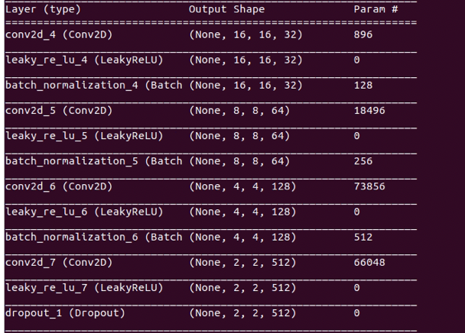

Slide 17
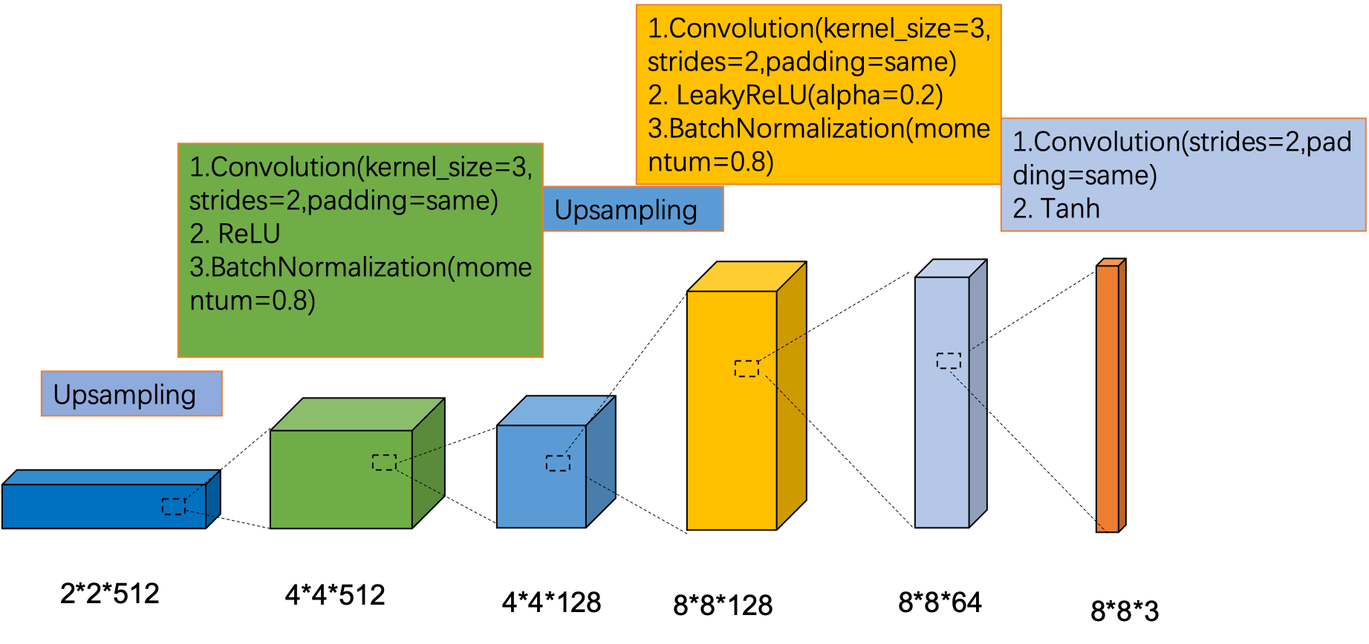
My simulated Structure decoder
Notes:
We now discuss the second half of our pipeline, the decoder, which generates pixels of the image using the encoder features.
the decoder is a series of up-convolutional layers with learned filters, each with a rectified linear unit (ReLU) activation function. A up-convolution is simply a convolution that results in a higher resolution image. It can be understood as upsampling followed by convolution. The intuition behind this is straightforward – the series of up-convolutions and non-linearities comprises a non-linear weighted upsampling of the feature produced by the encoder until we roughly reach the original target size.
Tracks:1. Upsampling 2. tanh

Slide 18
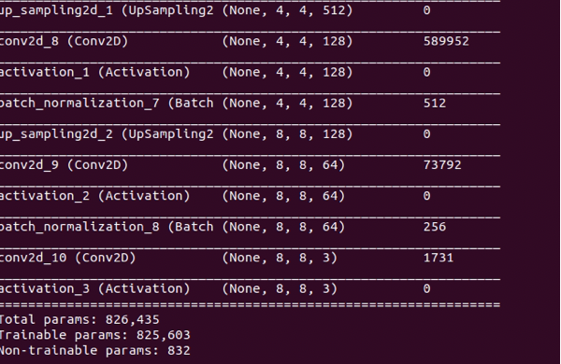

Slide 19
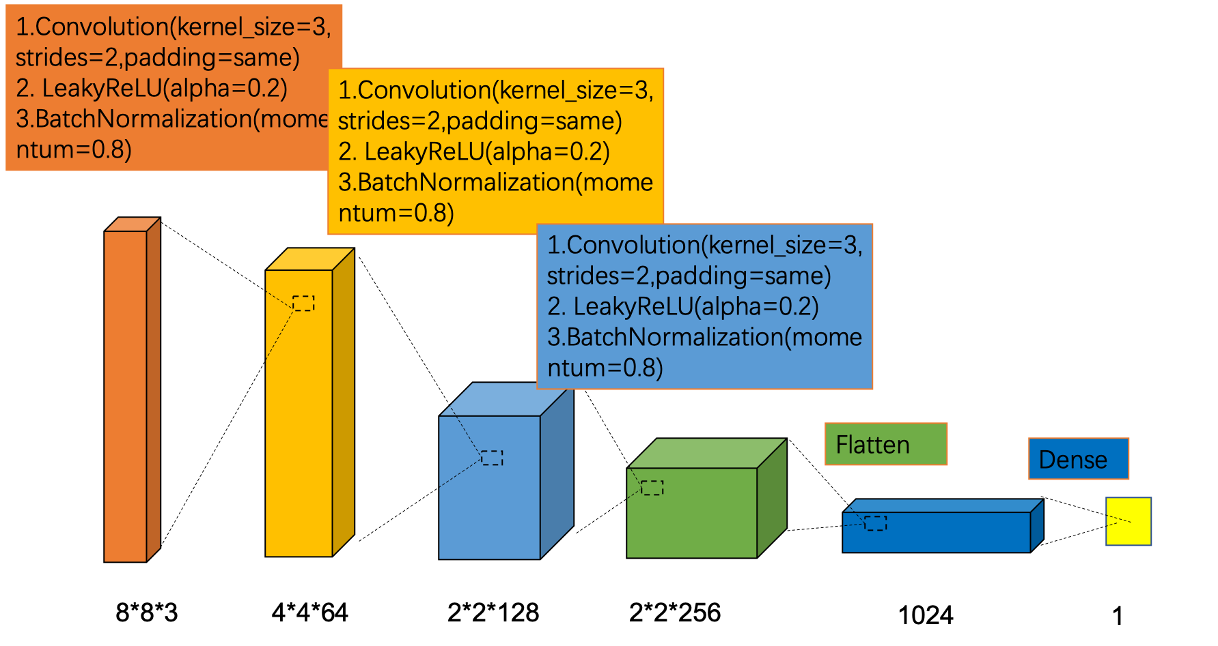
My simulated Structure discriminator
Notes:
The idea of the discriminator is that it is a deep neural network that acts as a classifier it looks at the input and it guesses whether the input is real or fake. the best that the discriminator can do is guess randomly and the generator is able to perfectly reproduce the training data.

Slide 20
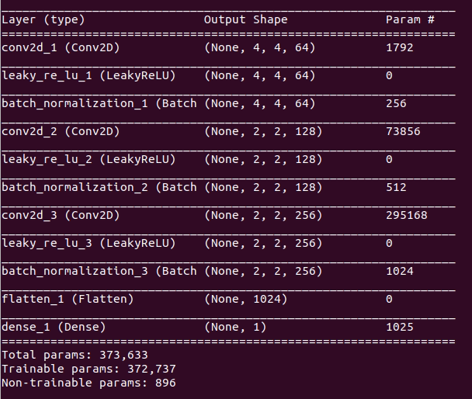

Slide 21
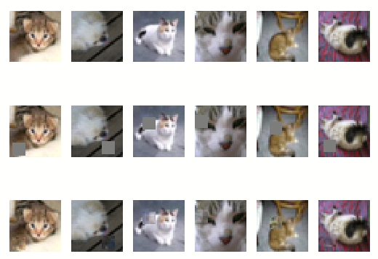
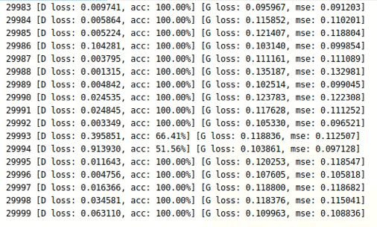
My Simulated Results (reconstruction loss + adversarial loss )
Notes:
joint loss significantly improves the inpainting over both reconstruction and adversarial loss alone. It alleviate the weaknesses of each of them.

Slide 22
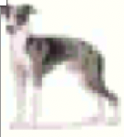
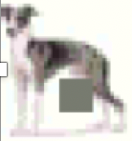
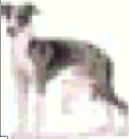



My Simulated Results

Slide 23
Conclusion
advantage
1. learn feature representations
2. conditioned on context advance the state of the art in semantic inpainting
disadvantage
1. boundary artifacts
2. distorted structures
3. blurry textures inconsistent with surrounding areas
Notes:
We found that a context encoder learns a representation that captures not just appearance but also the semantics of visual structures. We demonstrate the effectiveness of our learned
features for CNN pre-training on classification, detection, and segmentation tasks.

Slide 24
Future Work
More complex structure
Discriminator both global ly and locally
encoder
decoder
encoding
discriminator
MSE loss
GAN loss
More complex Loss Function
Notes:
Maybe this boundary artifacts, distorted structures and blurry textures inconsistent with surrounding areas is likely due to ineffectiveness of convolutional neural networks in modeling long-term correlations between distant contextual information and the hole regions. Thus, in my future work, I want to optimize the neural network structure and the loss function for improving the training stability and visual quality.

Slide 25
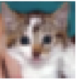
Brief example
AE
(coarse network)
AE
(refinement Network)
Global critic+ Local
critic
MSE loss For coarse result
Joint Loss
WGAN-GP Loss

Slide 26
Reference
[1] DP Kingma, M Welling. Auto-encoding variational bayes. arXiv preprint arXiv:1312.6114, 2013
[2] Habibi, Aghdam, Hamed. Guide to convolutional neural networks : a practical application to traffic-sign detection and classification. Heravi, Elnaz Jahani. Cham, Switzerland. ISBN 9783319575490. OCLC 987790957, April 2017.
[3] D. Pathak, P. Krahenbuhl, et al. Context encoders: Feature learning by inpainting. arXiv:1604.07379 [cs], April 2016.
[4] Goodfellow, I., Pouget-Abadie, J., Mirza, M., Xu, B., Warde-Farley, D., Ozair, S., ... & Bengio, Y. Generative adversarial nets. In Advances in neural information processing systems (pp. 2672-2680), 2014
[5]M. Heusel, H. Ramsauer, et al. Gans trained by a two time-scale update rule converge to a local nash equilibrium. arXiv:1706.08500 [cs, stat], June 2017. arXiv: 1706.08500.
[6] DP Kingma, M Welling. Auto-encoding variational bayes. arXiv preprint arXiv:1312.6114, 2013
[7]O. Russakovsky, J. Deng, H. Su, J. Krause, S. Satheesh, S. Ma, Z. Huang, A. Khosla, M.Bernstein, et al. Imagenet latge scale visual recognition challenge. International Jornal of Computer Vision, 115(3):211-252,2015
[8] Learning Multiple layers of Features from Tiny Images, Alex Krizhevsky, 2009

